Slide 1
Technical Support (420-1N6-AB) Hardware: Internal Components
Lecture from Fall 2022 Adapted for Fall 2024

Slide 2
NOTES
These slides will be useful for Assignment 1 / Lab 2
These slides may be updated in the future (put on the main course website, some content better explained). I will keep you posted about this.

Slide 3
Hardware – Inner Components

Slide 4
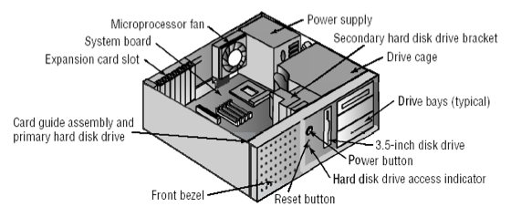
Inside A Computer

Slide 5
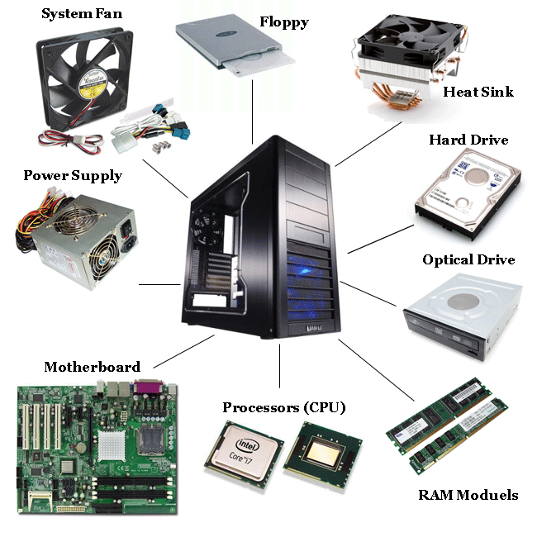
Internal Components
Main needs of a computer:
store information
process information
retrieve information
Auxiliary needs of a computer:
protection from elements/interference
source of electrical power
temperature management for heat generated
structure
communication between components
tiers of storage/processing specialized for different purposes

Slide 6
Internal Components
The components that fulfil these needs:
Case
Power Supply
Motherboard
Chipset
Buses
Connectors
Cooling Devices
Processor (CPU)
Graphics processor (GPU)
Memory (RAM)
Storage Devices (CD, HDD, SSD, NVME/M2)
We will learn about all of these components this week!

Slide 7
Important things to know about components
When discussing components of any complicated machine, we should try to understand the following about those components:
Make/model:
The brand and product name of the component.
E.g. Hyundai Accent (make = Hyundai, model = Accent)
Why it’s important: Who constructs these components? Are their multiple different versions of this component made by the same manufacturer? Why?
Properties:
The quantitative (numeric) and qualitative (non-numeric) traits of the component that can be compared with alike components
Quantitative e.g.: the Fuel Efficiency of the 2009 Hyundai Accent is 29 MPG (miles per gallon)
Qualitative e.g: The Hyundai Accent is a hatchback, not a sedan
Why it’s important:
what is the expected performance of this component?
Is their a cost/benefit for choosing a component with better suited properties than other components?
Etc.
These two ideas (make/model, properties) will vary significantly from component to component. You will need to know these ideas for all of the components we discuss today.

Slide 8
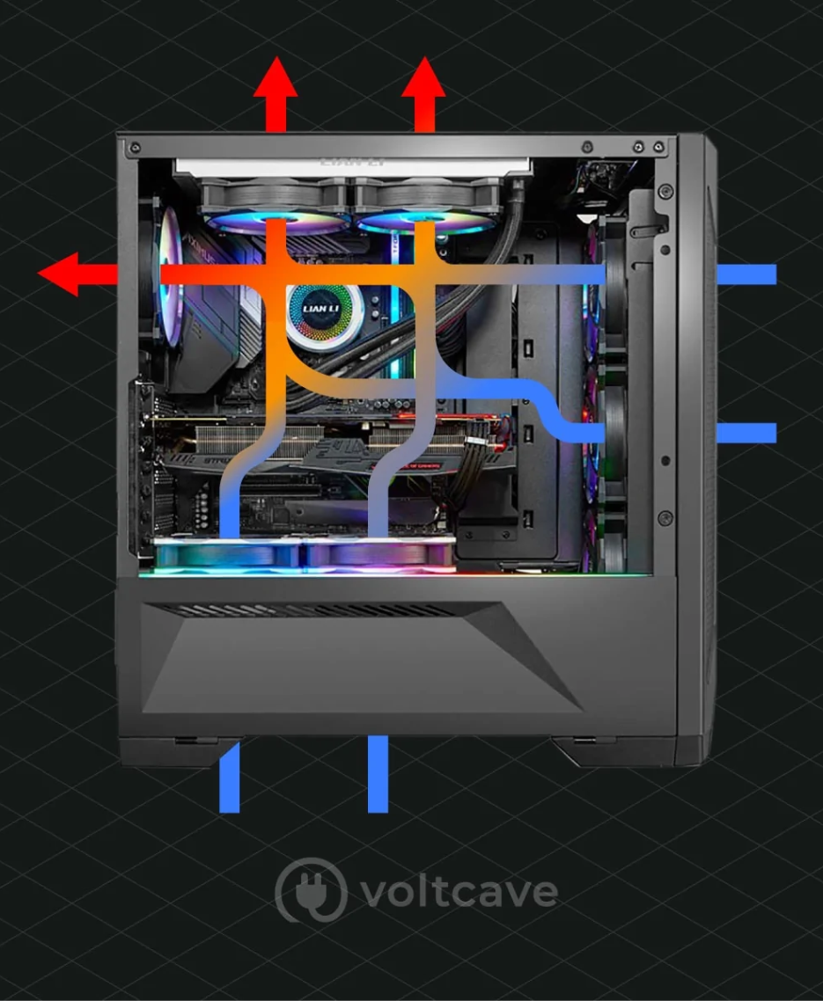
Internal Components: Case
Provides protection and cooling for the internal components.
Also prevents damage from static electricity (components grounded via attachment to case).
Usually made of plastic, steel or aluminum.
Fans move air through the case:
to replace warm air with cold air to keep components at stable temperatures
to prevent build-up of dust
There exist many guides/studies for optimal airflow. E.g. https://voltcave.com/pc-airflow-guide/

Slide 9
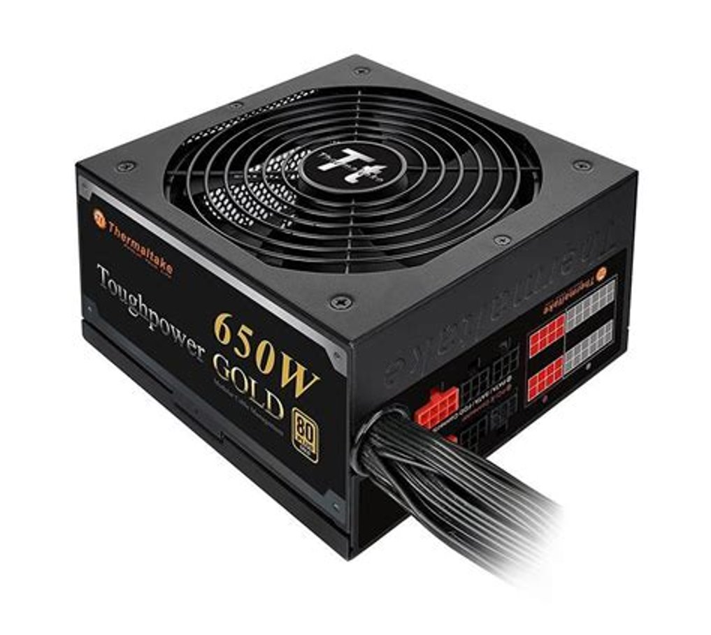
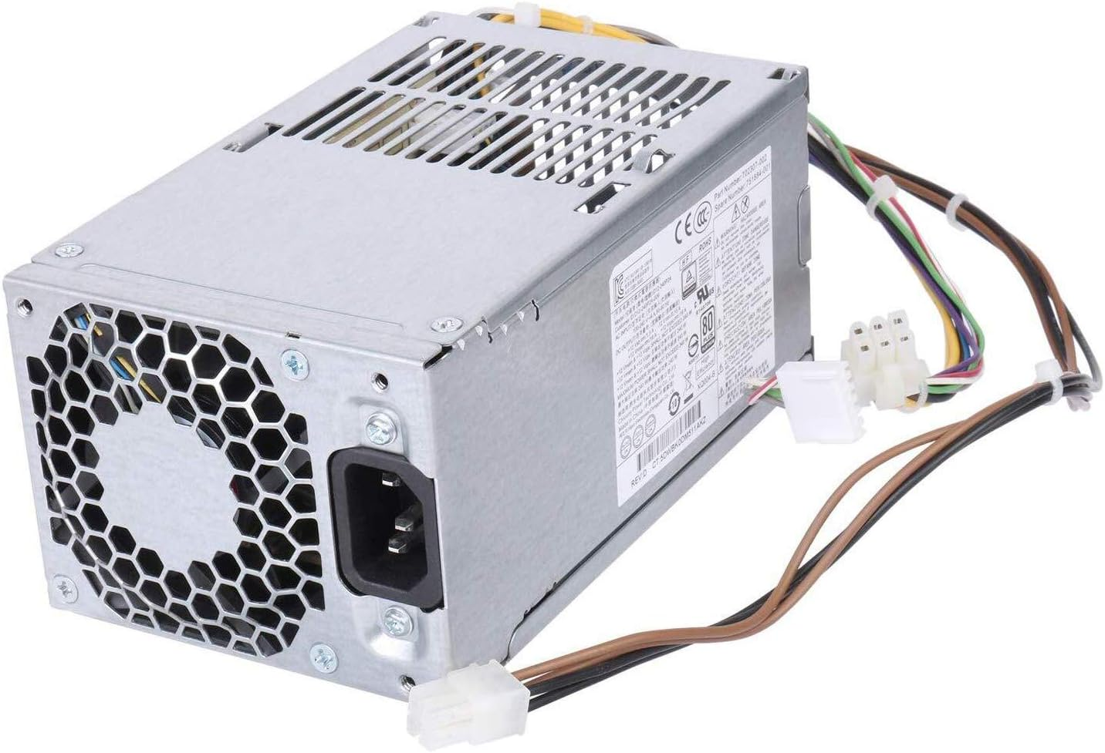
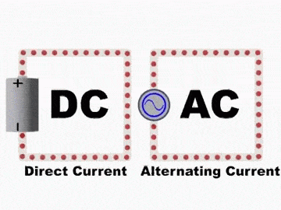
Power Supply
Main purpose: Converts AC power (alternating current) from wall socket to DC power (direct current). Direct current (0 or 5V) is used to power digital circuits.
Note: PSU have their own fans:
Energy conversion releases a lot of heat!

Slide 10
Uninterruptible Power Supply
In the case of a power outage, an Uninterruptible Power Supply (UPS) can keep a computer running for a few minutes to several hours depending on the sophistication of the UPS. See https://www.wikihow.com/Buy-and-Use-an-Uninterruptible-Power-Supply for an example.
It’s basically a large battery that keeps charge during normal operation, and powers a computer using its stored charge when the building’s power is cut off.
We will talk more about uninterruptible power supply when we start speaking about server hardware.

Slide 11
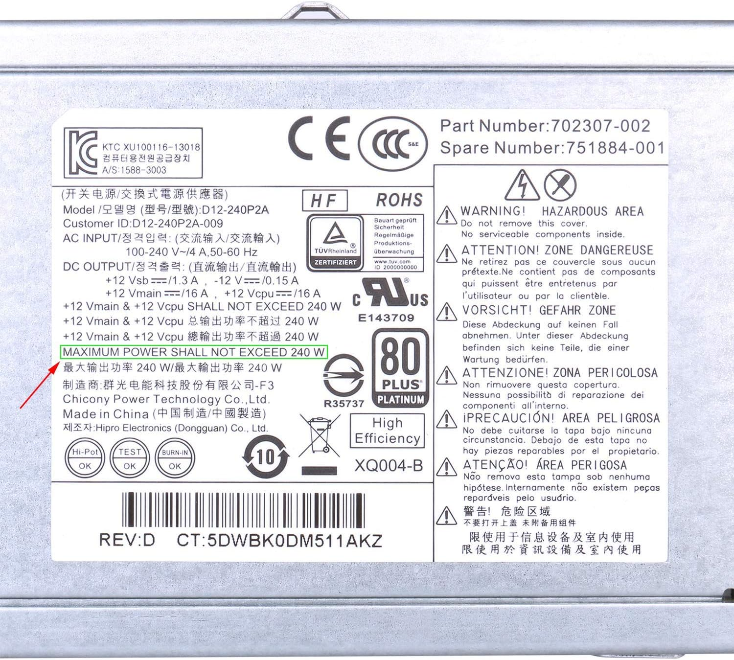
Power Supply
Computers can only tolerate slight fluctuations in power without needing to shut down
.
Important: Never open a power supply! The capacitors contained within can keep a dangerous high voltage, high power charge long after being unplugged.
Demo: PSU What are the supported DV outputs?

Slide 12
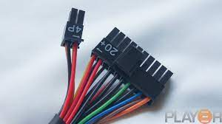
Power Supply Connectors
Most power supply connectors are : 20 + 4 pins
Usually made up of wires of various colors:
Yellow 12V
Red 5V
Orange 3.3V
Other colors may be ground 0V

Slide 13
Power Supply Ratings
Useful for Assignment 1
Ratings:
Wattage (amount of power delivered, must be greater than the sum of power required by all parts, some power supplies can provide more power than others)
Efficiency (1st + 2nd Laws of thermodynamics: 100% power input cannot be converted to 100% power output; some power supplies have higher efficiency ratings than others)
For more detailed explanation: https://www.newegg.com/insider/how-to-choose-a-pc-power-supply-buying-guide/

Slide 14
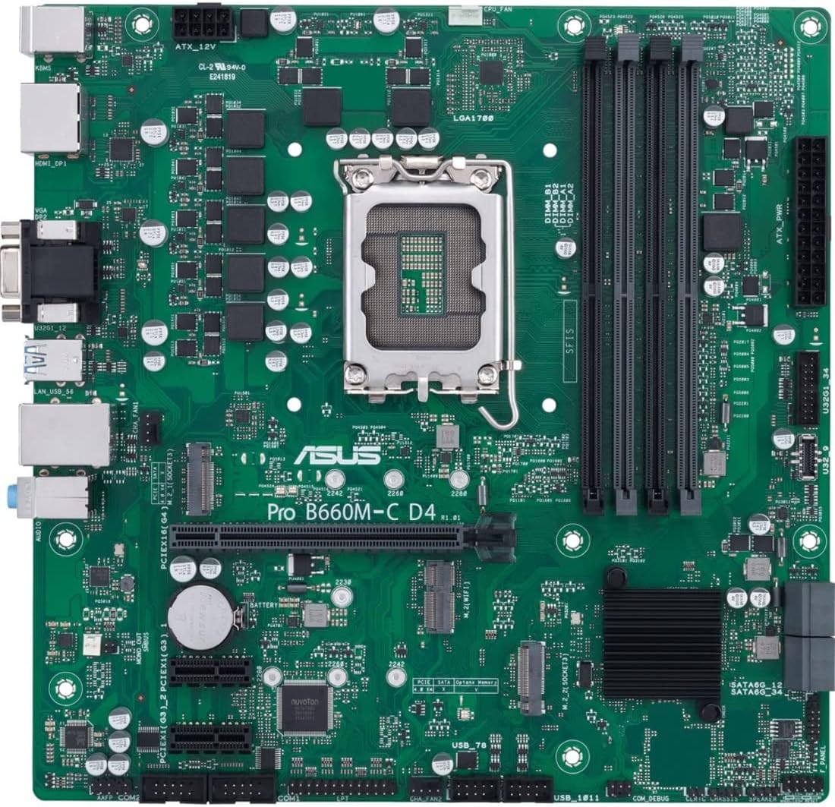
Motherboard (overview)
Connects the CPU, RAM, Expansion ports.
Composed of various chips all combined into north and south bridges
More on those in a few weeks...

Slide 15
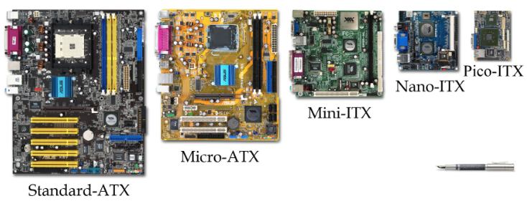
Motherboard (overview)
Main circuit board and controls the electrical pathways (buses) found in a computer.
The buses allow data to travel between the various components of a computer.
Various form factors, e.g. AT, ATX, LPX, BTX, ITX.

Slide 16
Internal Components: Motherboard – Form Factors (I)
AT
Invented by IBM in early 1980s, now obsolete.
Huge in size (approximately 12 x 13 inches).
Needed lots of space for power supply and its various chips.
Lacked external ports, only allowed for monitor and keyboard.
ATX
Created in 1995 to meet the need for more connectors.
Got off to a slow start but by 1998 became the most common form factor.
Biggest change to AT was the rear panel with standard set of ports for expansion.
Power supply position for better airflow, CPU and RAM positioned for easier access.
Variations 12x9in (full size), 9.6x9.6in (microATX)
ATX and microATX are the most common in personal desktop computers today

Slide 17
Internal Components: Motherboard – Form Factors (II)
ITX
Created in 2001 to meet the demand for smaller computers.
ITX failed but led to development of smaller form factor (SSF) motherboards.
MiniITX (6.7x6.7in), NanoITX (4.7x4.7in) and PicoITX (3.8x2.8in)
Commonly used for embedded systems and specialized devices such as routers.
Require very little power, therefore produce less heat.
Proprietary
Some computer manufacturers make motherboards that work only with their cases.
Services and upgrades usually need to be handled by authorized dealers.
Often hard to get replacement parts and they are usually expensive.

Slide 18
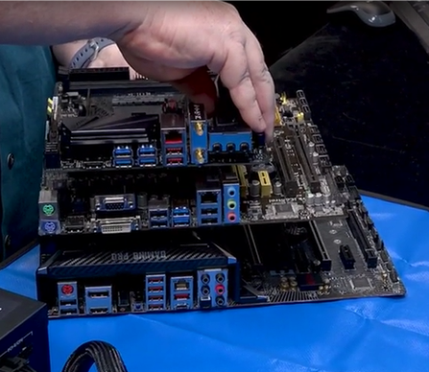
Motherboard - Ports
You'll notice that the I/O Ports (input/output) on the mother board are always located around the same area.
This is to keep certain consistency across manufacturer and regardless of the form factors

Slide 19
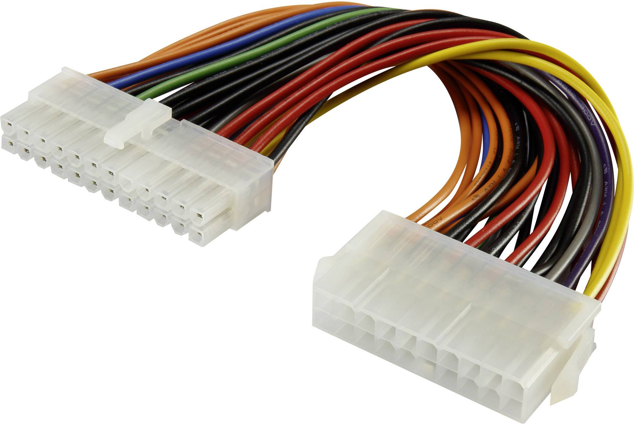
Internal Components: Connectors
There are a variety of connectors used to connect components to the motherboard. Two main purposes:
Signals: for communication/data transfer
Power: not all components connect directly to the power supply, they get power from the motherboard
Most connectors are keyed (can only be inserted one way).
Note: Always check the pins if you have trouble with a connector.
“If it doesn’t go in like butter, it doesn’t go in at all” -- never force a connection! you are likely going to damage the pins.

Slide 20
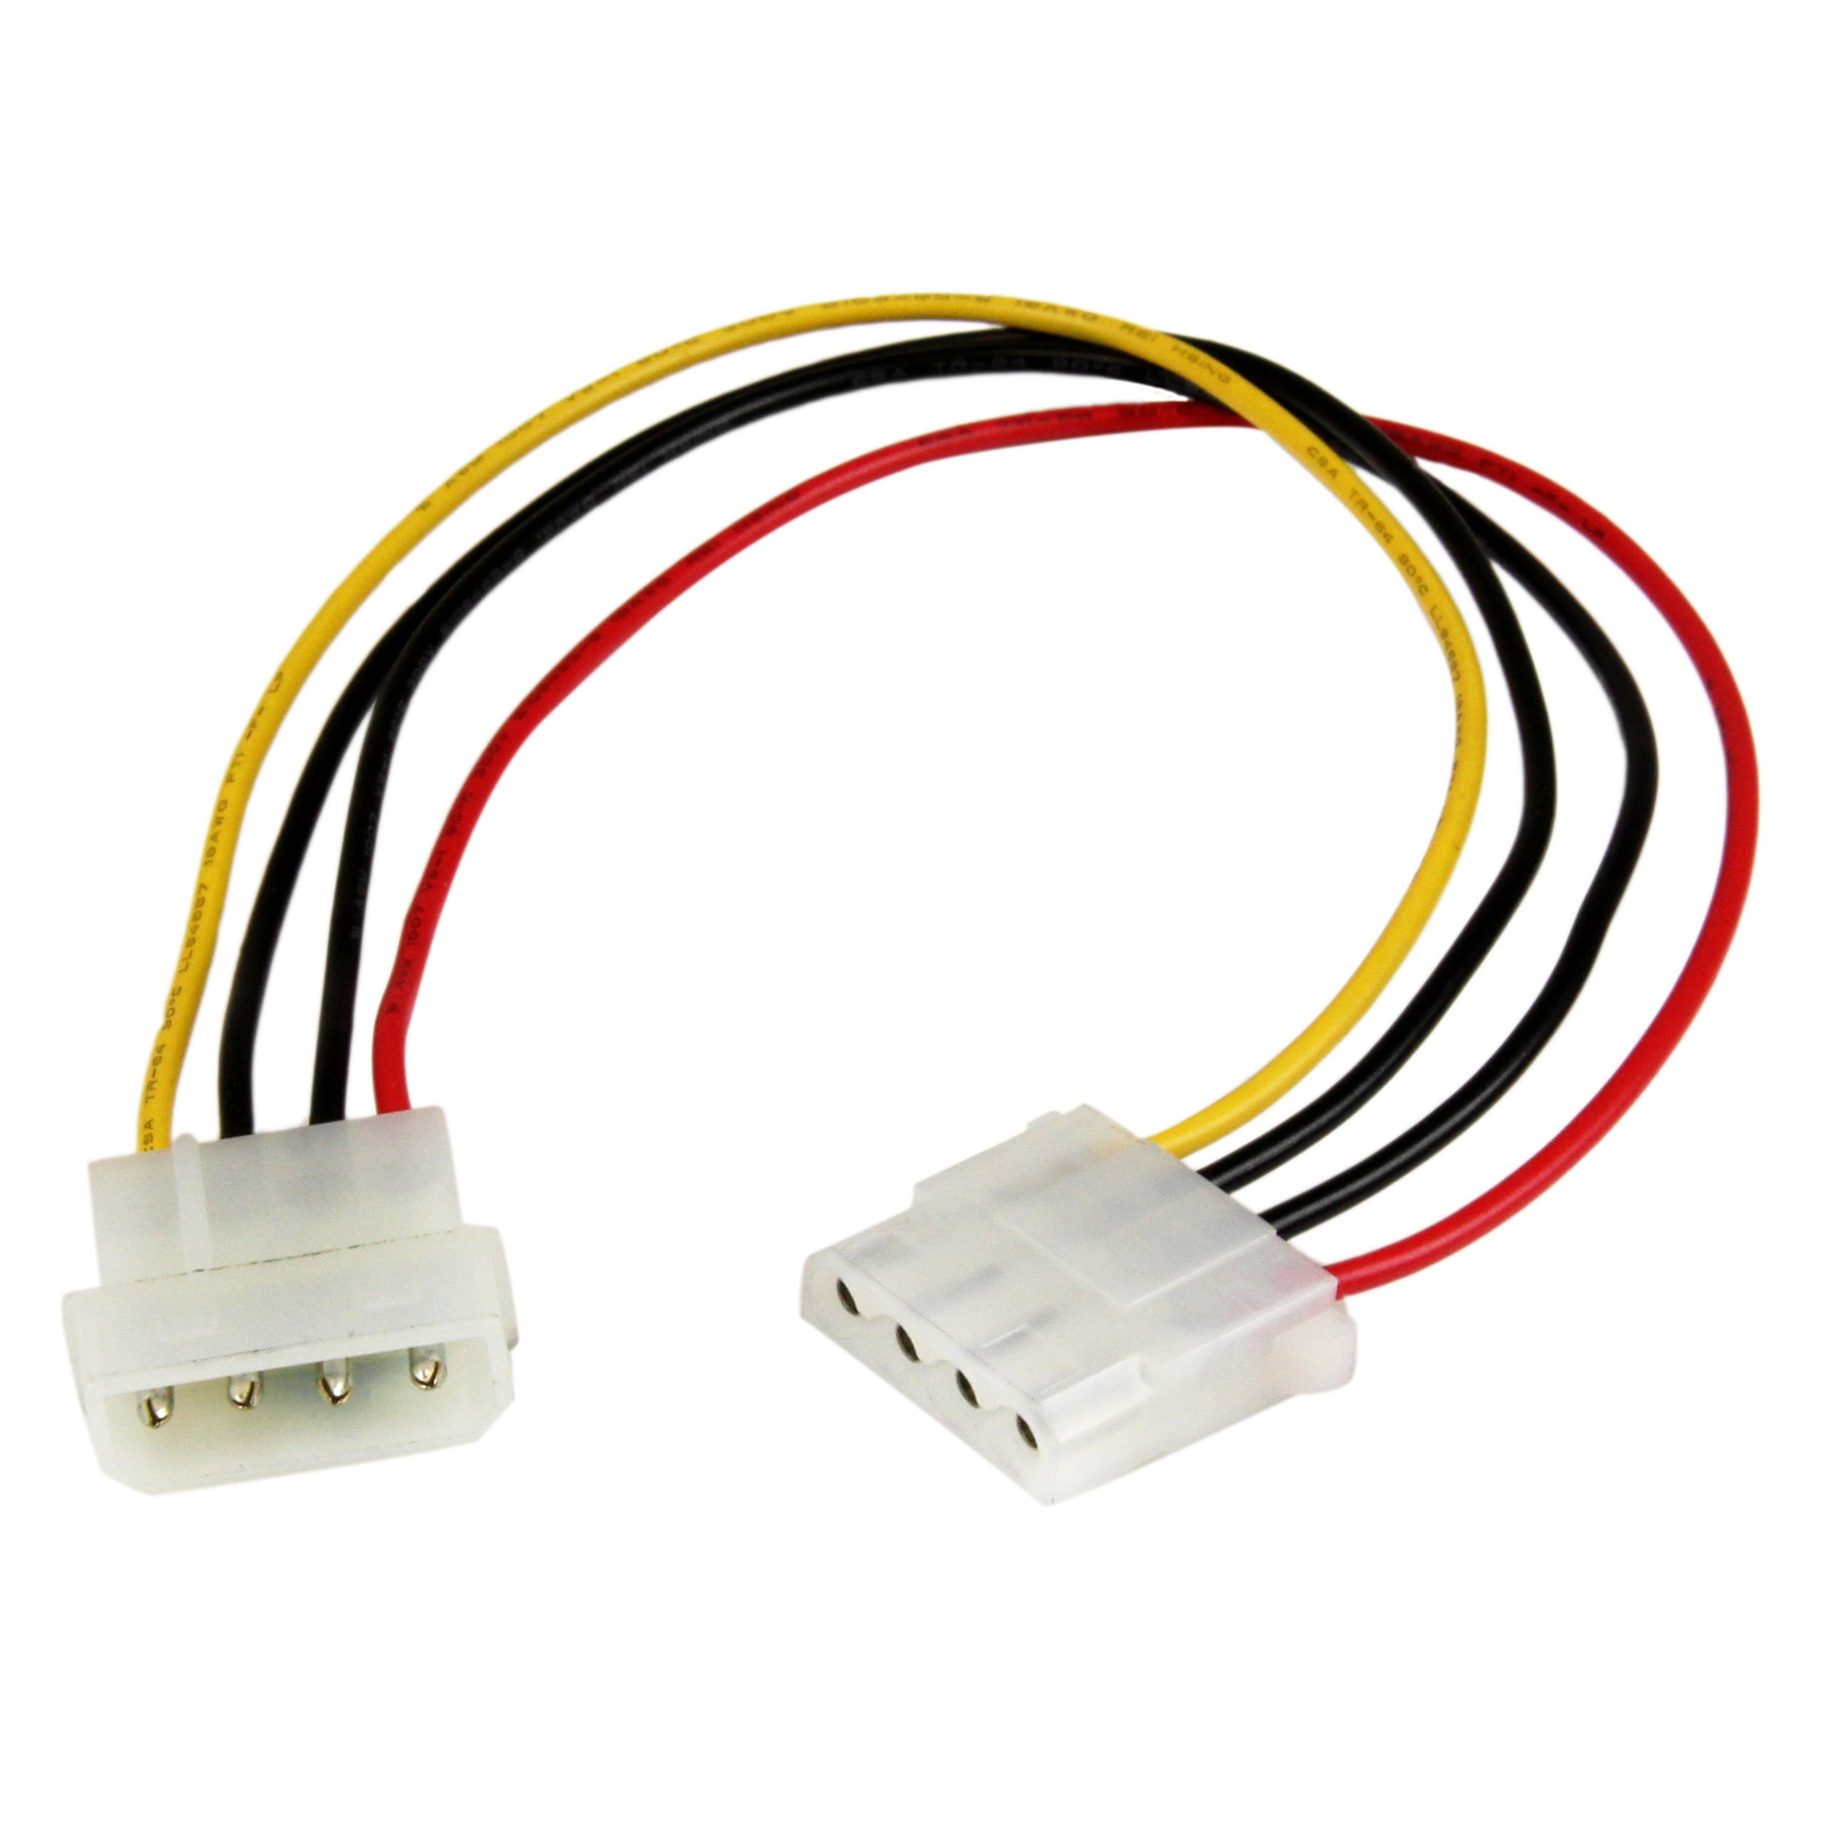
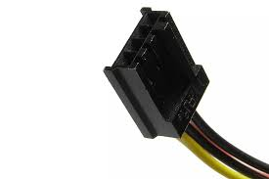
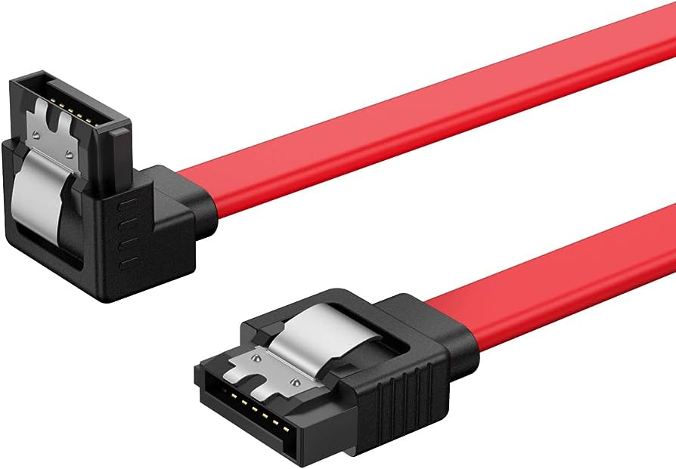
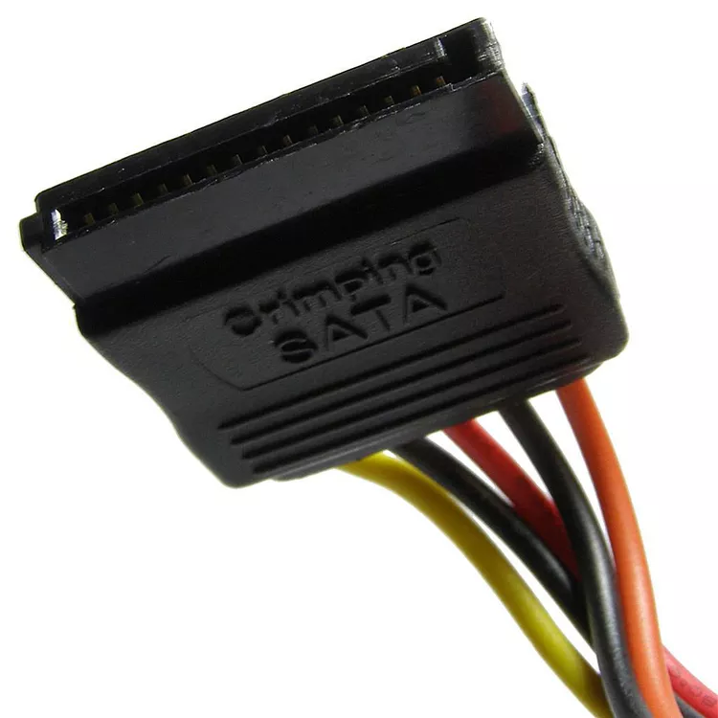
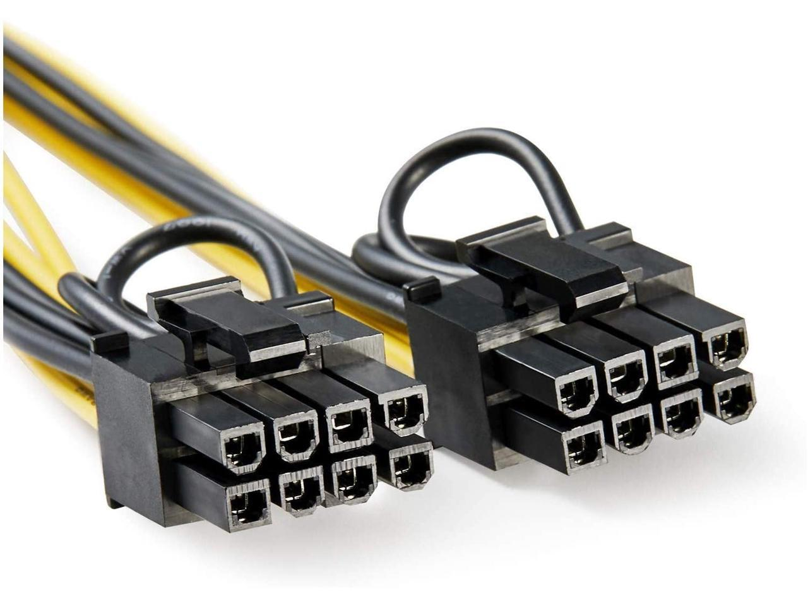
Types of connectors
Floppy drive connectors (old days)
SATA Cables (for hard drives)
Molex
Power
Data
PCIe (Video Cards)

Slide 21
Motherboard – Expansion Slots
Let’s have a closer look at what we call expansion slots.
Expansion slots are ports inside a computer found on the motherboard. They provide the possibility to expand the hardware of your PC.
For example, you may want to install a network card, a sound card, and most commonly, a video card.

Slide 22
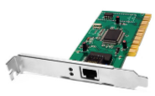
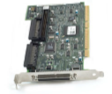
Motherboard: Expansion Slots
Expansion slots allow us to increase the functionality of a computer by adding controllers for specific devices (often called adapter cards) e.g. sound, video, NIC (network Interface Card).
PCI used in most computers, commonly used for network interface
AGP designed to be used by video adapters
PCIe replaces AGP in newer computers, used for video cards
ISA older, rarely used, 8 or 16 bit
EISA older, rarely used, 32 bit
MCA IBM proprietary 32 bit, older, rarely used
PCI-X 32 bit, can run up to four times faster than PCI
MiniPCI 32 bit, used by laptops, has three different form factors
In 2024: PCI and PCIe are the common standards that cover all features required for expansion slots

Slide 23
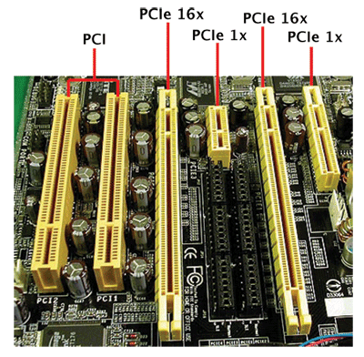
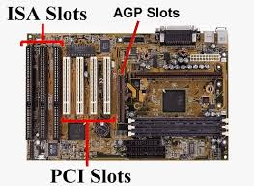
Motherboard: Expansion Slots

Slide 24
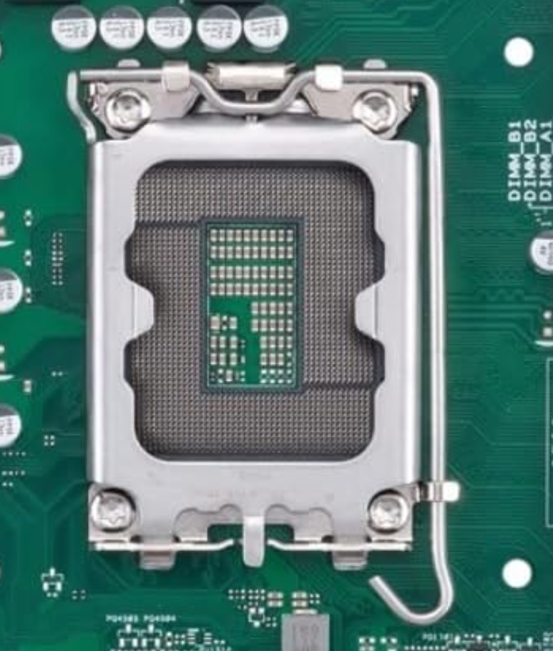
Motherboard – CPU Socket
Let’s have a closer look at the CPU Socket: This is where the CPU will sit

Slide 25
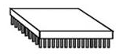
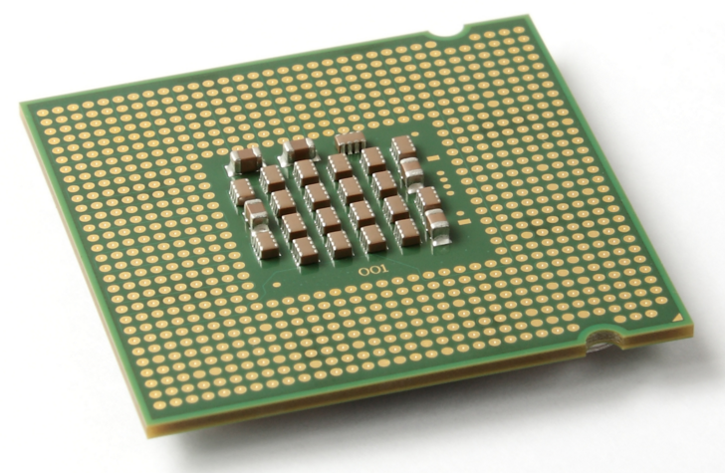
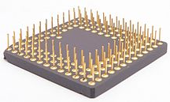
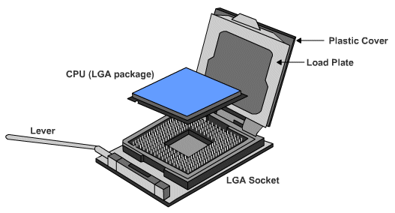
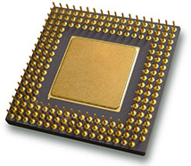
How to Connect a CPU?
CPU connection on the motherboard is known as the CPU socket.
The CPU is connected to the motherboard in one of two ways:
Pin Grid Array – PGA
Pins are on the CPU (underside of the processor).
Socket on motherboard includes holes that line up with the CPU pins.
Land Grid Array – LGA
Pins are on the motherboard (on socket) instead of on the processor.

Slide 26
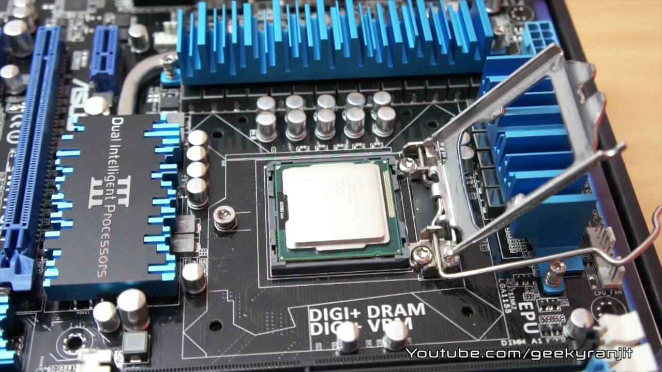
CPU
Most important element of the computer in terms of computing power.
Brains of the computer.
Responsible for interpreting and executing the commands from the software.
While the CPU is processing one step of the program, the remaining instructions and the data are stored in a special memory called cache.
More on this in the coming weeks

Slide 27
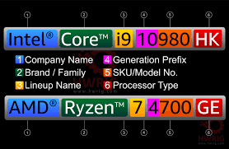
CPU Brands
Intel
AMD
Historically the main CPU manufacturer
Relatively recent competitor to Intel

Slide 28
Cooling Devices
The flow of current between and within electronic components generates heat. Some devices are particularly powerful heat-generators, due to the large current they draw:
CPUs typically come with their own cooling device
Cooling devices are built into GPUs and Power Supplies
Fans inside the case increase airflow and removes heat.
Heat sinks also draw heat away from the CPU core.
A heat sink is a piece of copper or aluminum that resides between the processor and the CPU fan.
It absorbs the heat from the processor and the fan disperses the heat.

Slide 29
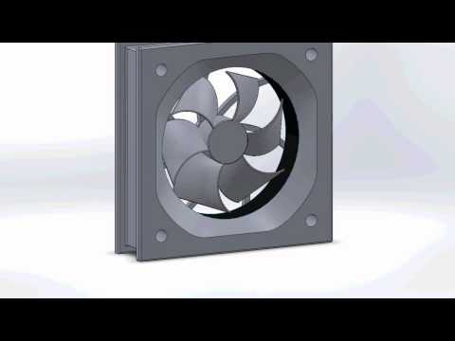
Cooling Devices - Fans
The flow of current between the electronic components generates heat.
Fans inside the case increase airflow and removes heat.
Occasionally video cards or other components have their own fans to cool them.

Slide 30
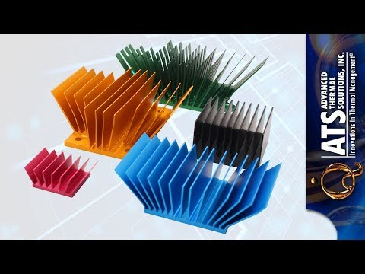
Cooling Devices – Heat sinks
Heat sinks also draw heat away from the CPU core.
A heat sink is a piece of copper or aluminum that resides between the processor and the CPU fan.
It absorbs the heat from the processor and the fan disperses the heat.
Increase of the surface area

Slide 31
Memory - RAM
Let’s have a closer look at the RAM slots on the motherboard

Slide 32
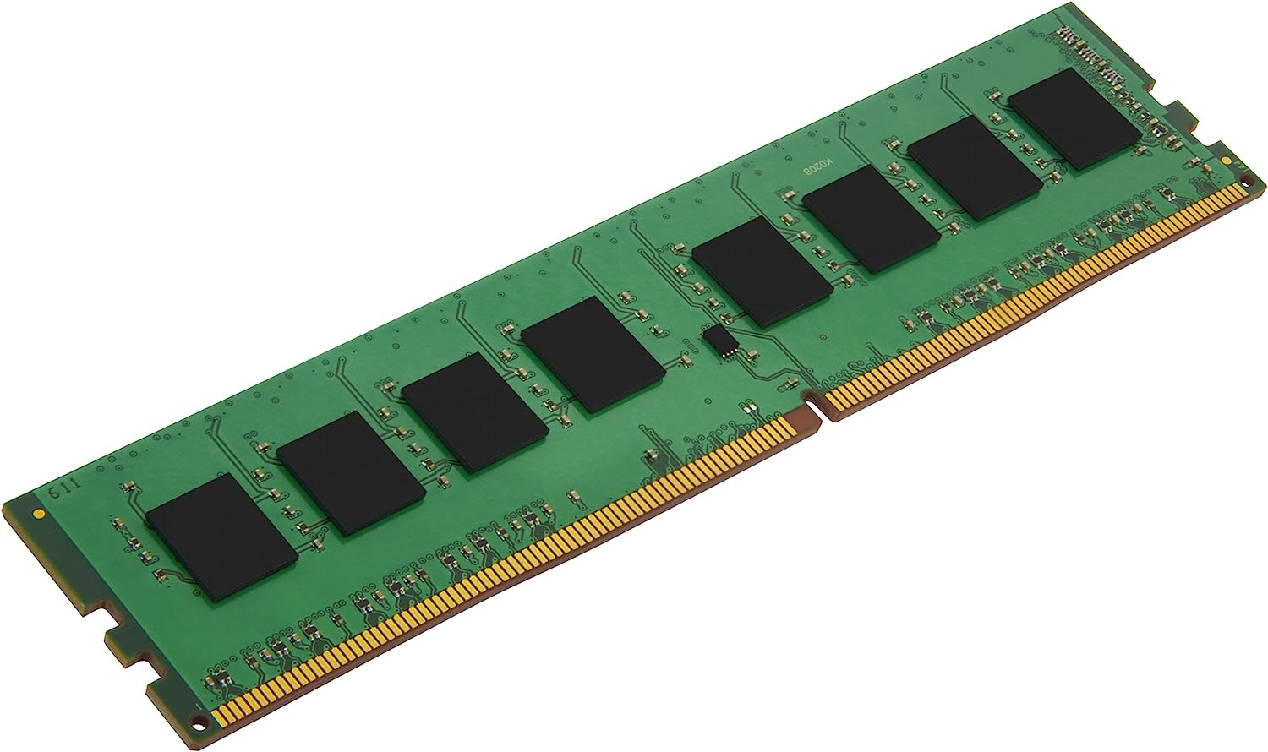
Main Memory
Referred to as RAM (Random Access Memory)
RAM is a collection of integrated circuits (chips)
Temporary storage for data and programs that are being accessed by the CPU.
Volatile memory: contents are erased when the computer is switched off. (or when power is lost)

Slide 33
Main Memory (cont.)
There are four main properties of RAM to know:
Capacity: Total memory (in GB, GigaBytes)
More RAM means more capacity to hold and process large programs and files.
Maximum installed is limited by the motherboard and the operating system.
Speed: How many operations per second
Many, millions or billions per second
1MHz = 1 million / second, 1 GHz = 1 billion / second
Latency: How much time delay between communications
Generation: See next slides

Slide 34
Memory Modules Design Types
SIMMs (Single In-Line Memory Modules)
Have a single line of connectors.
Now obsolete.
DIMMs (Dual In-Line Memory Modules)
Have two lines of connectors.
Have Wider bus (supports 64 bits) 🡪 How can this help? More on this in the coming weeks.
Became dominant (no need to state that a memory module is a DIMM).

Slide 35
Memory Modules Generations (oldest to newest, approximately)
Synchronous DRAM (SDRAM) | DRAM that operates in time with the memory bus. Tied to the system clock like the CPU and the memory controller. Results in very little wasted time.
Double Data Rate SDRAM (DDR) | DDR transfers data twice as fast as SDRAM. Larger buffer gives it a huge boost.
Double Data Rate 2 SDRAM (DDR2) | DDR2 decreases noise making it faster than DDR.
Double Data Rate 3 SDRAM (DDR3) | DDR3 doubles the clock rate of DDR2, consumes less power and generates less heat.
Double Data Rate 4 SDRAM (DDR4) | DDR4 arrived in 2014 with even faster speeds. (most common RAM type in desktops/laptops today)
Double Data Rate 5 SDRAM (DDR5) | Introduced in 2020, is starting to become more widely adopted.
NOTE: Motherboards are usually compatible with only ONE generation of RAM. If you have a motherboard designed for DDR3, it cannot use DDR4 or DDR5.

Slide 36
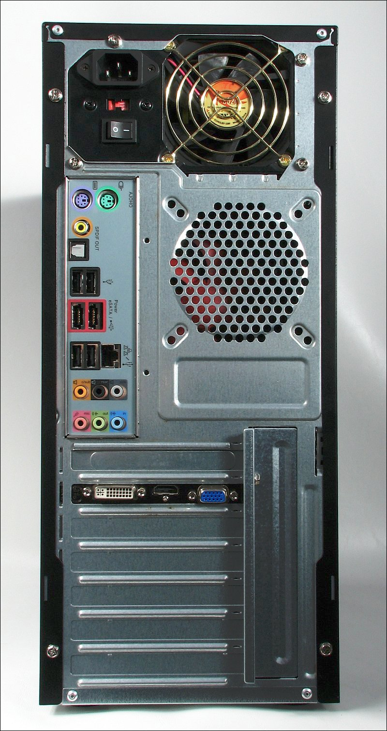
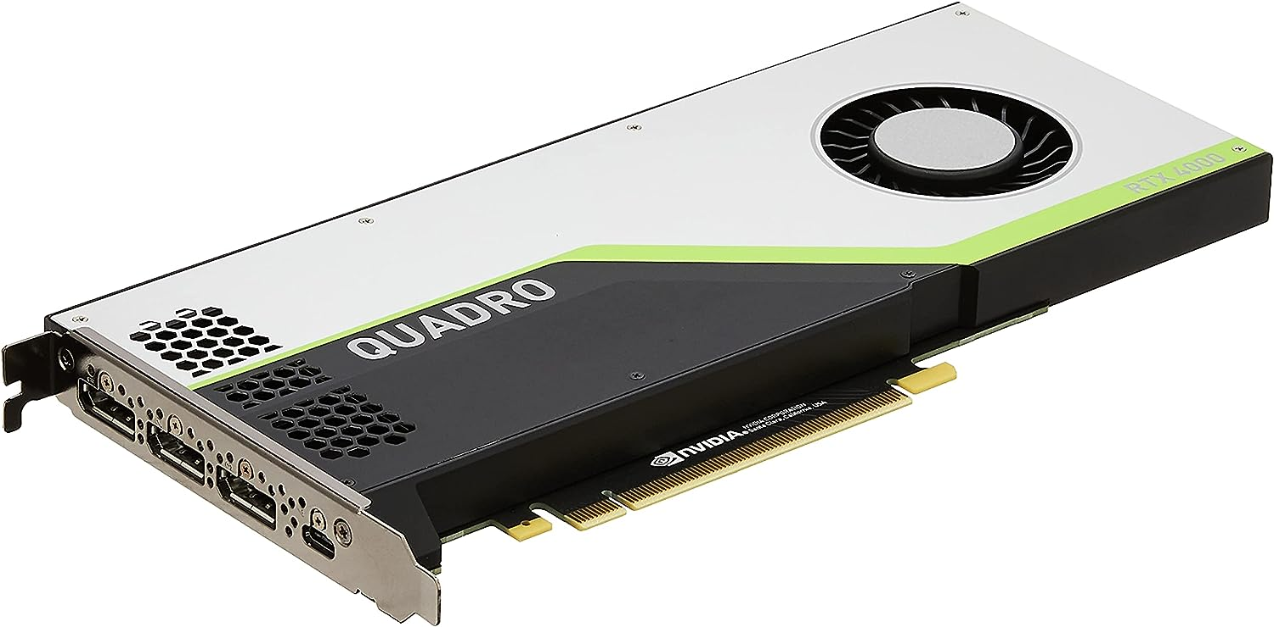
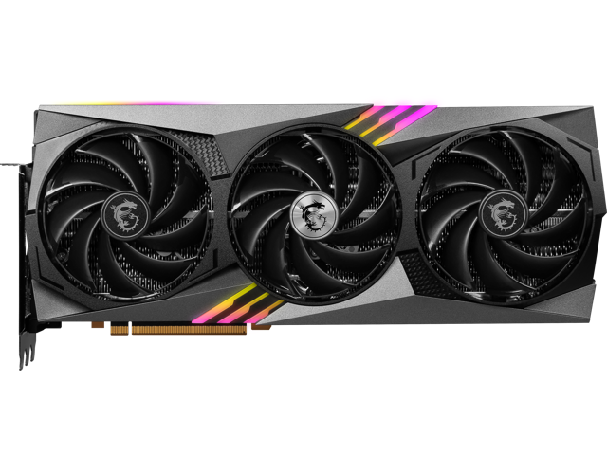
Graphics Cards (GPU)
Also known as Video cards or Graphical Processing Units
One of the most interesting use of expansion slots is the addition of video cards, also known as Graphical Processing Unit.
A specialized version of a CPU designed for graphical processing (producing complex output to display on a monitor)
The computation needed for graphical processing is generally useful for scientific computing as well (lots of data in parallel)

Slide 37
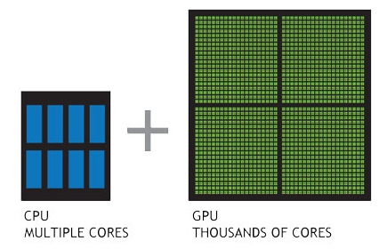
GPU & CPU, things in common
Both consume a lot of power and generate a lot of heat
More powerful CPUs/GPUs require more powerful power supplies
TDP: Thermal Design Power, measures the number of Watts needed to power the device
Both have performance measured in speed (operations/second) like RAM

Slide 38
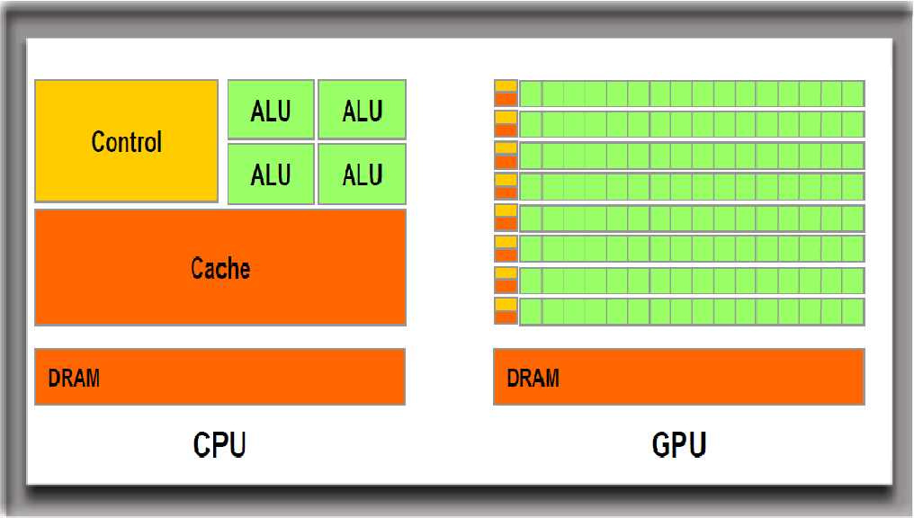
CPU vs GPU
GPU cannot replace the CPU because their architecture is different and meant for different purposes
GPU is great to parallelize computations!
But the GPU is not as versatile as the CPU which has a larger instruction set

Slide 39
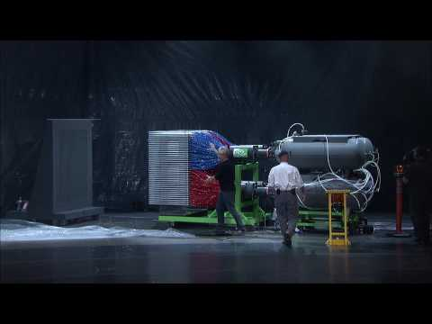
GPU vs CPU
(click to load the video)

Slide 40
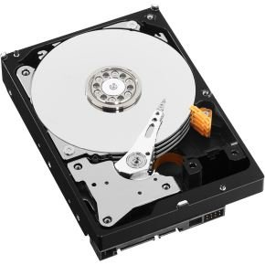
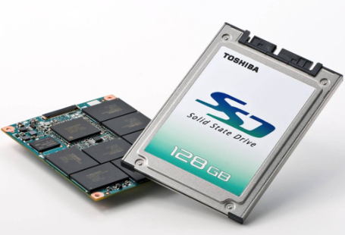
Storage Devices
Storage devices store data permanently.
Some are installed inside the case (e.g. hard drive);
Some are removable and portable (e.g. external flash drive).

Slide 41
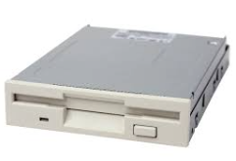
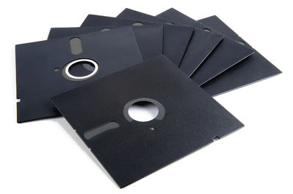
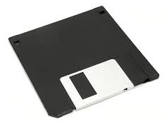
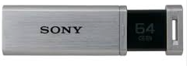
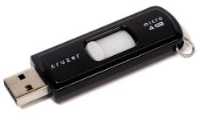
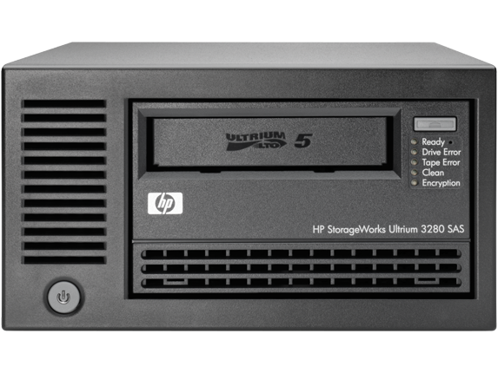
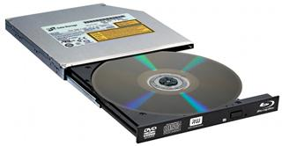
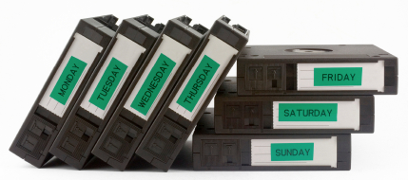
Storage Devices (cont.)

Slide 42
Storage Devices: Floppy Drive
Uses 3.5 inch floppy disks (or 5.25 inch floppy disks - older).
Largely obsolete.
Magnetic disks store up to 1.44Meg of data.

Slide 43
Storage Devices: Hard Drive
Hard Disk Drive (HDD)
Traditional hard drives.
Uses magnetic-based storage on a moving disk (somewhat like a vinyl player)
Magnetic hard drives have drive motors that spin the magnetic platters and move the drive heads.
Speed measured in revolutions per minute

Slide 44
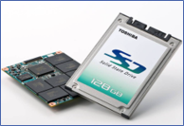
Storage Devices: Hard Drive
Solid State Drives (SSD)
Do not have moving parts and use semi-conductors to store data.
Non-volatile flash memory chips manage the storage on an SSD, resulting in faster access to data, higher reliability and reduced power usage.

Slide 45
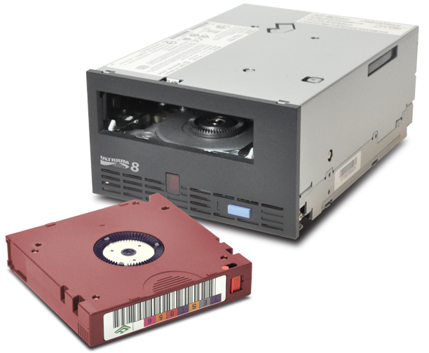
Storage Devices: Tape Drive
Magnetic tapes are often used for backups or archiving data. Impractical for most individuals, but still used/created to this day! Cost effective when storing more than 1000 TB (lots and lots of data)

Slide 46

Storage Devices: Optical Drive
Uses lasers to read the data on the optical media.
CD (compact disc) 700 Mb
DVD (digital versatile disc) 4-8 Gb.
BD (Blu-ray disc) 25-50 Gb.
Optical media can be:
Pre-recorded (read only)
Recordable (write once)
Re-recordable (read and write multiple times).

Slide 47
Storage Devices: External Flash Drive
Removable storage device that connects to a USB port.
These use the same type of non-volatile memory chips as SSDs and do not require power to maintain the data.

Slide 48
Storage Devices: Interfaces
To install a drive internally in a computer, the connection interface on the drive must be the same as the controller on the motherboard.
Motherboards support different types of interfaces.

Slide 49
Storage Devices: Interfaces Types (In order of oldest to newest)
IDE | Integrated Drive Electronics / Advanced Technology Attachment. Also called ATA. Early drive controller interface, originally only supported hard drives up to 540 MB. Uses a 40 pin connector, and maximum cable length of 46cm (18in).
EIDE | Enhanced Integrated Drive Electronics (also called ATA-2). Updated version of IDE, supporting larger drives and direct memory access. Uses a 40 pin connector.
PATA | Parallel version of ATA. Used internally due to maximum cable length of 46cm (18in). Largely replaced by SATA in newer systems.
SATA (most commonly used today) | Serial version of ATA, with slimmer and longer cables providing better airflow. Uses 7-pin connector (less pins means less issues with electromagnetic interference). SATA hard drives tend to be quieter than IDE drives.

Slide 50
Storage Devices: Interfaces Types (cont.)
eSATA | External serial ATA, provides a hot-swappable external interface for SATA.
SCSI | Small Computer System Interface. Drive controller that can connect up to 15 drives. Internal and external use, uses 25, 50 or 68 pin connector.
Note: Hot-swapping is the ability to connect and disconnect a device while the computer is on.

Slide 51

Computer Memory Hierarchy
Source: https://en.wikipedia.org/wiki/Memory_hierarchy

